Slide 1

AGB1211 – DESIGN THINKING
Department of Artificial Intelligence and Data Science
Academic Year: 2024 – 2025 (Odd Semester)
Year : II
Semester : III
Section : B
Date : 06.12.2024
PRESENTED BY
1. SEVENHILLSVASA S 2. SHAHUL HAMEED 3. SHEIK MOHAMMED
AGB1211 – DESIGN THINKING

Slide 2
Title of the Project
LEARN / PLAY FOR CHILDREN WITH DISABILITIES
AGB1211 – DESIGN THINKING

Slide 3
Problem Identification
Children with disabilities face difficulties in learning.
There are not enough fun and helpful tools for them.
Schools often don’t have inclusive learning options for all children.
Many tools do not meet specific needs (like visual, hearing, or movement challenges).
AGB1211 – DESIGN THINKING

Slide 4
Objective
for children
To help children with disabilities feel included and accepted.
To build their confidence through earning and playing activities.
To teach them important skills for daily life and independence.
To encourage creativity and personal growth.
To help them make friends and interact with others in a fun way.
AGB1211 – DESIGN THINKING

Slide 5
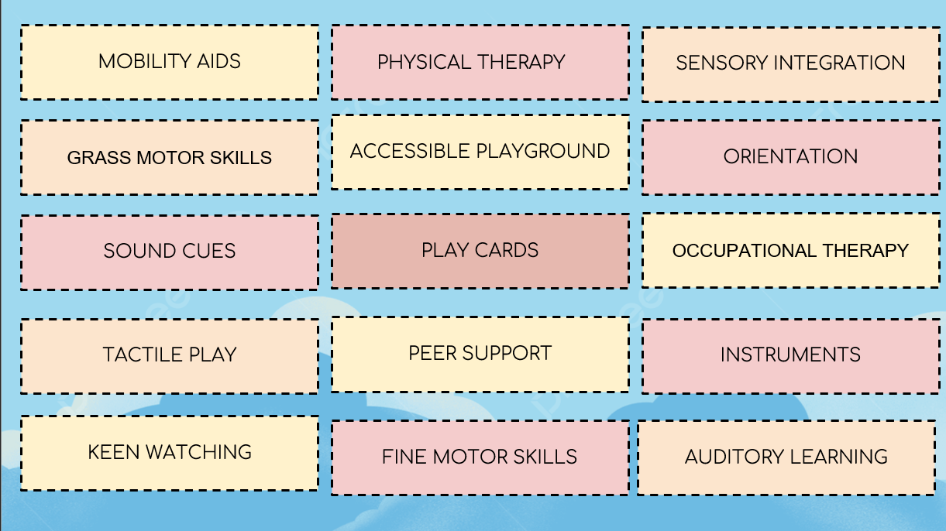
Brain Storming
AGB1211 – DESIGN THINKING

Slide 6
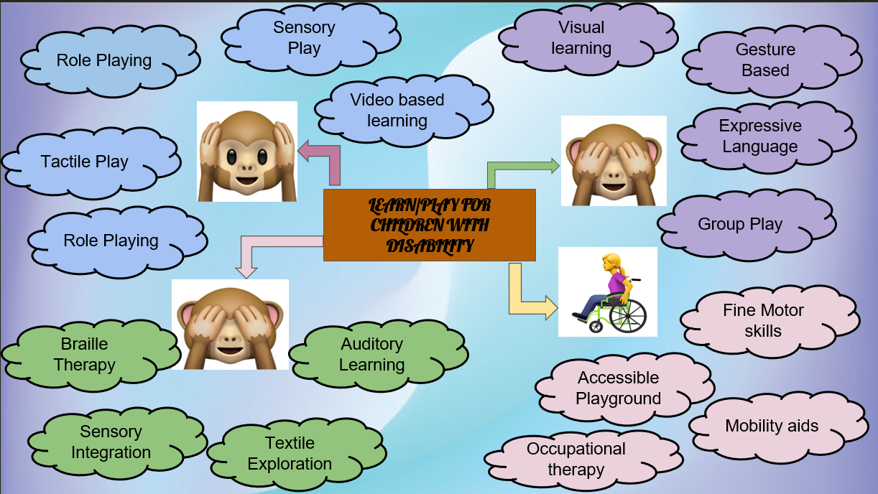
Mind Map
AGB1211 – DESIGN THINKING

Slide 7
Primary Research
Surveys & Interviews: Talked to parents, teachers, and caregivers.
Key Findings:
  Parents want engaging learning platforms.
  There’s a need for tools that track progress.
What We Observed:
  Kids enjoy learning through games.
  Current apps don’t have good accessibility features.
AGB1211 – DESIGN THINKING

Slide 8
Secondary Research
Current Apps: Studied what tools are already available.
  Some apps are good but lack inclusivity.
Market Needs:
More inclusive tools are needed.
  The global market for assistive tech is growing fast.
Research Findings: Technology can really help children with disabilities learn better
AGB1211 – DESIGN THINKING

Slide 9
Proposed Work
Design: Figma for making easy-to-use app layouts.
Accessibility Features: Text-to-speech, AR (augmented reality), and touch feedback for children.
Data Analysis: AI to adjust learning based on the child’s progress.
AGB1211 – DESIGN THINKING

Slide 10
List of Modules
Module 1: Gamified Learning
Module 2: Accessibility Settings
Module 3: Parent-Teacher Dashboard
AGB1211 – DESIGN THINKING

Slide 11
Module 1 Description
Module 1: Gamified Learning
Interactive Activities: Quizzes and puzzles that fit the child's needs.
Rewards: Badges and points to encourage progress.
  Example: A math game to practice numbers.
  Example: Word puzzles to improve vocabulary.
AGB1211 – DESIGN THINKING

Slide 12
Module 2 Description
Module 2: Accessibility Settings
Features:
  Bigger font sizes and color changes.
  Audio instructions for kids with visual impairments.
  Gesture controls for kids with motor impairments.
AGB1211 – DESIGN THINKING

Slide 13
Module 3 Description
Module 3: Parent-Teacher Dashboard
Shows how the child is doing in the app.
Gives tips to parents or teachers on how to help the child improve.
AGB1211 – DESIGN THINKING

Slide 14
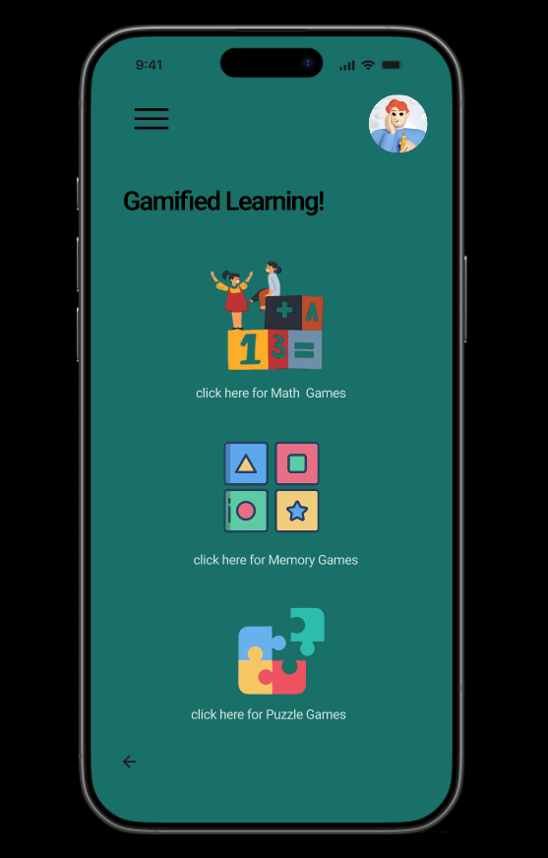
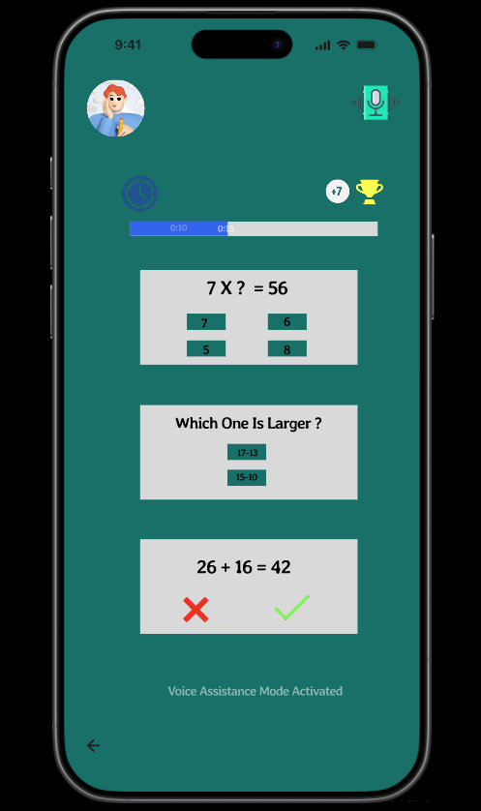
Results
AGB1211 – DESIGN THINKING

Slide 15
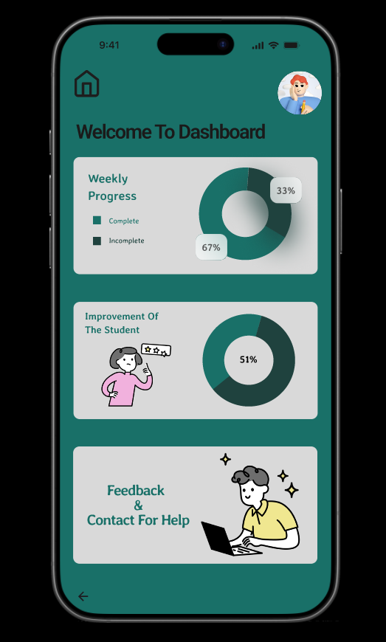
Results
AGB1211 – DESIGN THINKING

Slide 16
Conclusion
Helps children with disabilities feel included and valued.
Boosts their confidence through fun and meaningful activities.
Builds important skills like independence and creativity.
Encourages them to make friends and connect with others.
Creates a supportive and caring environment for all children.
AGB1211 – DESIGN THINKING

Slide 17
Thank You
ANY QUERIES???
AGB1211 – DESIGN THINKING

